Slide 1
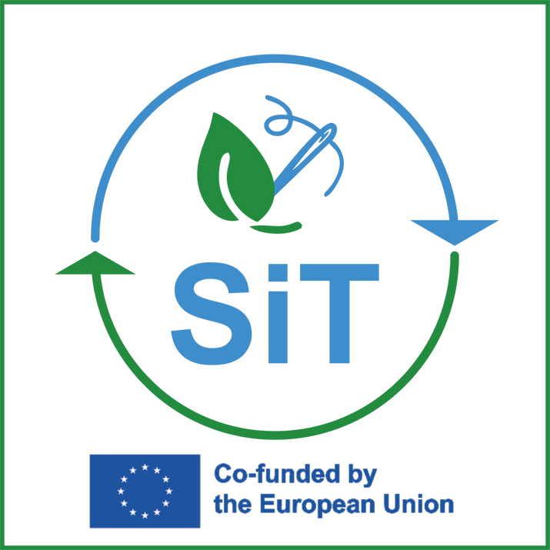






FEBRUARY 2025
Newsletter n. 7
Project news!
SiT
Sustainability in TCLF
Welcome to the SiT newsletter! We're excited to share our project's early activities and updates with you. In this edition, you'll find the presentation of our official project website.
The Emerging Roles for a Sustainable Future
The clothing industry's environmental impact is significant, involving harmful chemicals and waste.
To combat this, companies should adopt sustainable practices, such as using eco-friendly materials and circular economy models, while also reducing greenhouse gas emissions through renewable energy and optimized supply chains.
To ensure a sustainable future for the fashion industry, it is also important to prioritize social responsibility, this includes fair labor practices, ethical sourcing, and the protection of human rights. By working with suppliers who adhere to these standards, companies can contribute to a more equitable and just industry.
Another relevant challenge is the talent gap: companies are struggling to find skilled workers, especially in areas like design and production, to bridge this gap, it is essential to invest in education and training programs to equip individuals with the necessary competencies.
To meet these challenges, two emerging professions have been identified as pivotal by SiT project:
  the Bio-Textile Technician
  the Recycling Manager
As the TCLF sector continues its green transition, equipping professionals with the right skills and competencies will be critical for achieving a sustainable and competitive future.

Slide 2
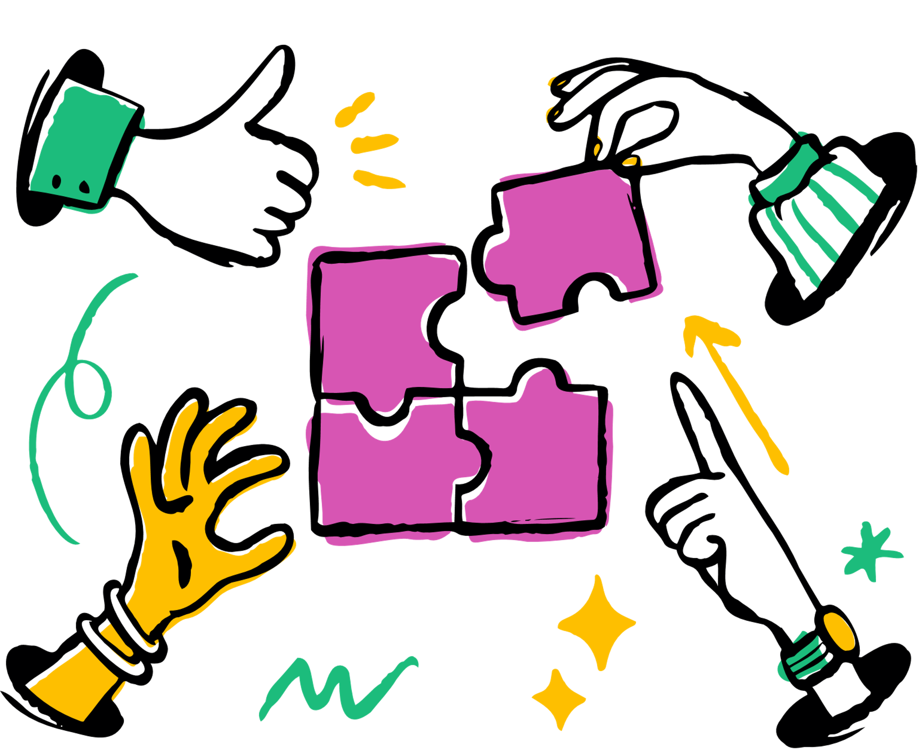
Project news!
Why these roles matter
Together, these professions bridge innovation and sustainability, addressing environmental challenges while meeting industry standards.
The collaboration between Bio-Textile Technicians and Recycling Managers is essential for building a more responsible and sustainable future in the sector.
The innovative materials engineered by Bio-Textile Technicians, when combined with the Recycling Manager’s expertise in waste reduction, create a holistic system that safeguards environmental health while facilitating the production of high-quality, durable products.
Bio-Textile Technician
Bio-Textile Technicians specialize in developing cutting-edge, eco-conscious materials.
This job focusses on designing biodegradable and naturally sourced fibers that significantly reduce environmental impact. Compared to conventional synthetic fibers, these fibers require less water and fewer harmful chemicals.
The primary objective of the Bio-Textile Technician is to engineer textiles that are not only environmentally sustainable but also robust and of superior quality.
By doing so, they help the fashion industry transition from resource-intensive, environmentally detrimental manufacturing practices to innovative approaches that align with growing consumer demand for sustainability.
Recycling Manager
Recycling Managers play a critical role in promoting zero-waste production and optimizing the reuse of materials throughout the textile and fashion sectors.
They evaluate manufacturing workflows to devise strategies for recycling, reusing, or upcycling textile waste, thereby prolonging the life cycle of materials and curbing the volume of textile waste directed to landfills. They may facilitate the conversion of discarded garments into new fibers or repurpose textile scraps into alternative products.
Recycling Managers’ efforts are fundamental in mitigating the environmental footprint of the fashion industry and advancing the principles of the circular economy, where materials are continuously repurposed rather than discarded after a single use.
Their contribution ensures that production processes become more sustainable and the reuse of textiles becomes standard practice, significantly reducing resource consumption.

Slide 3


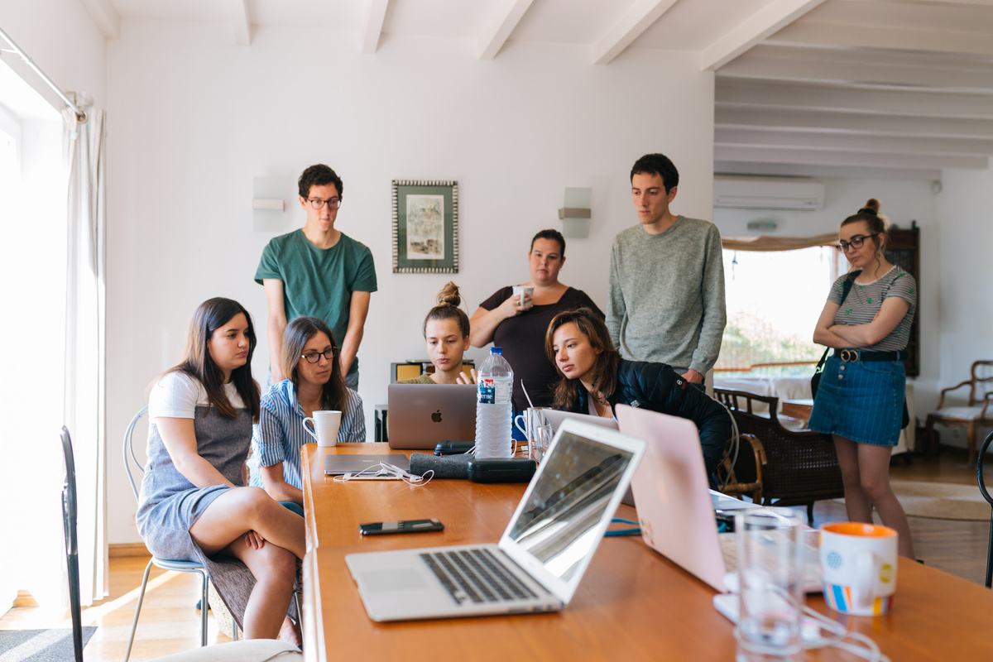
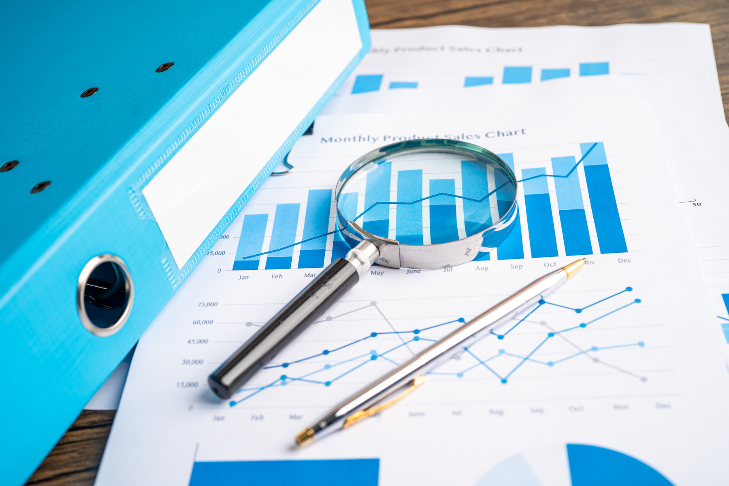
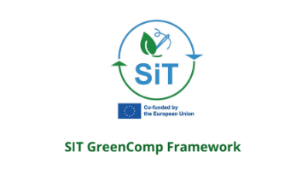


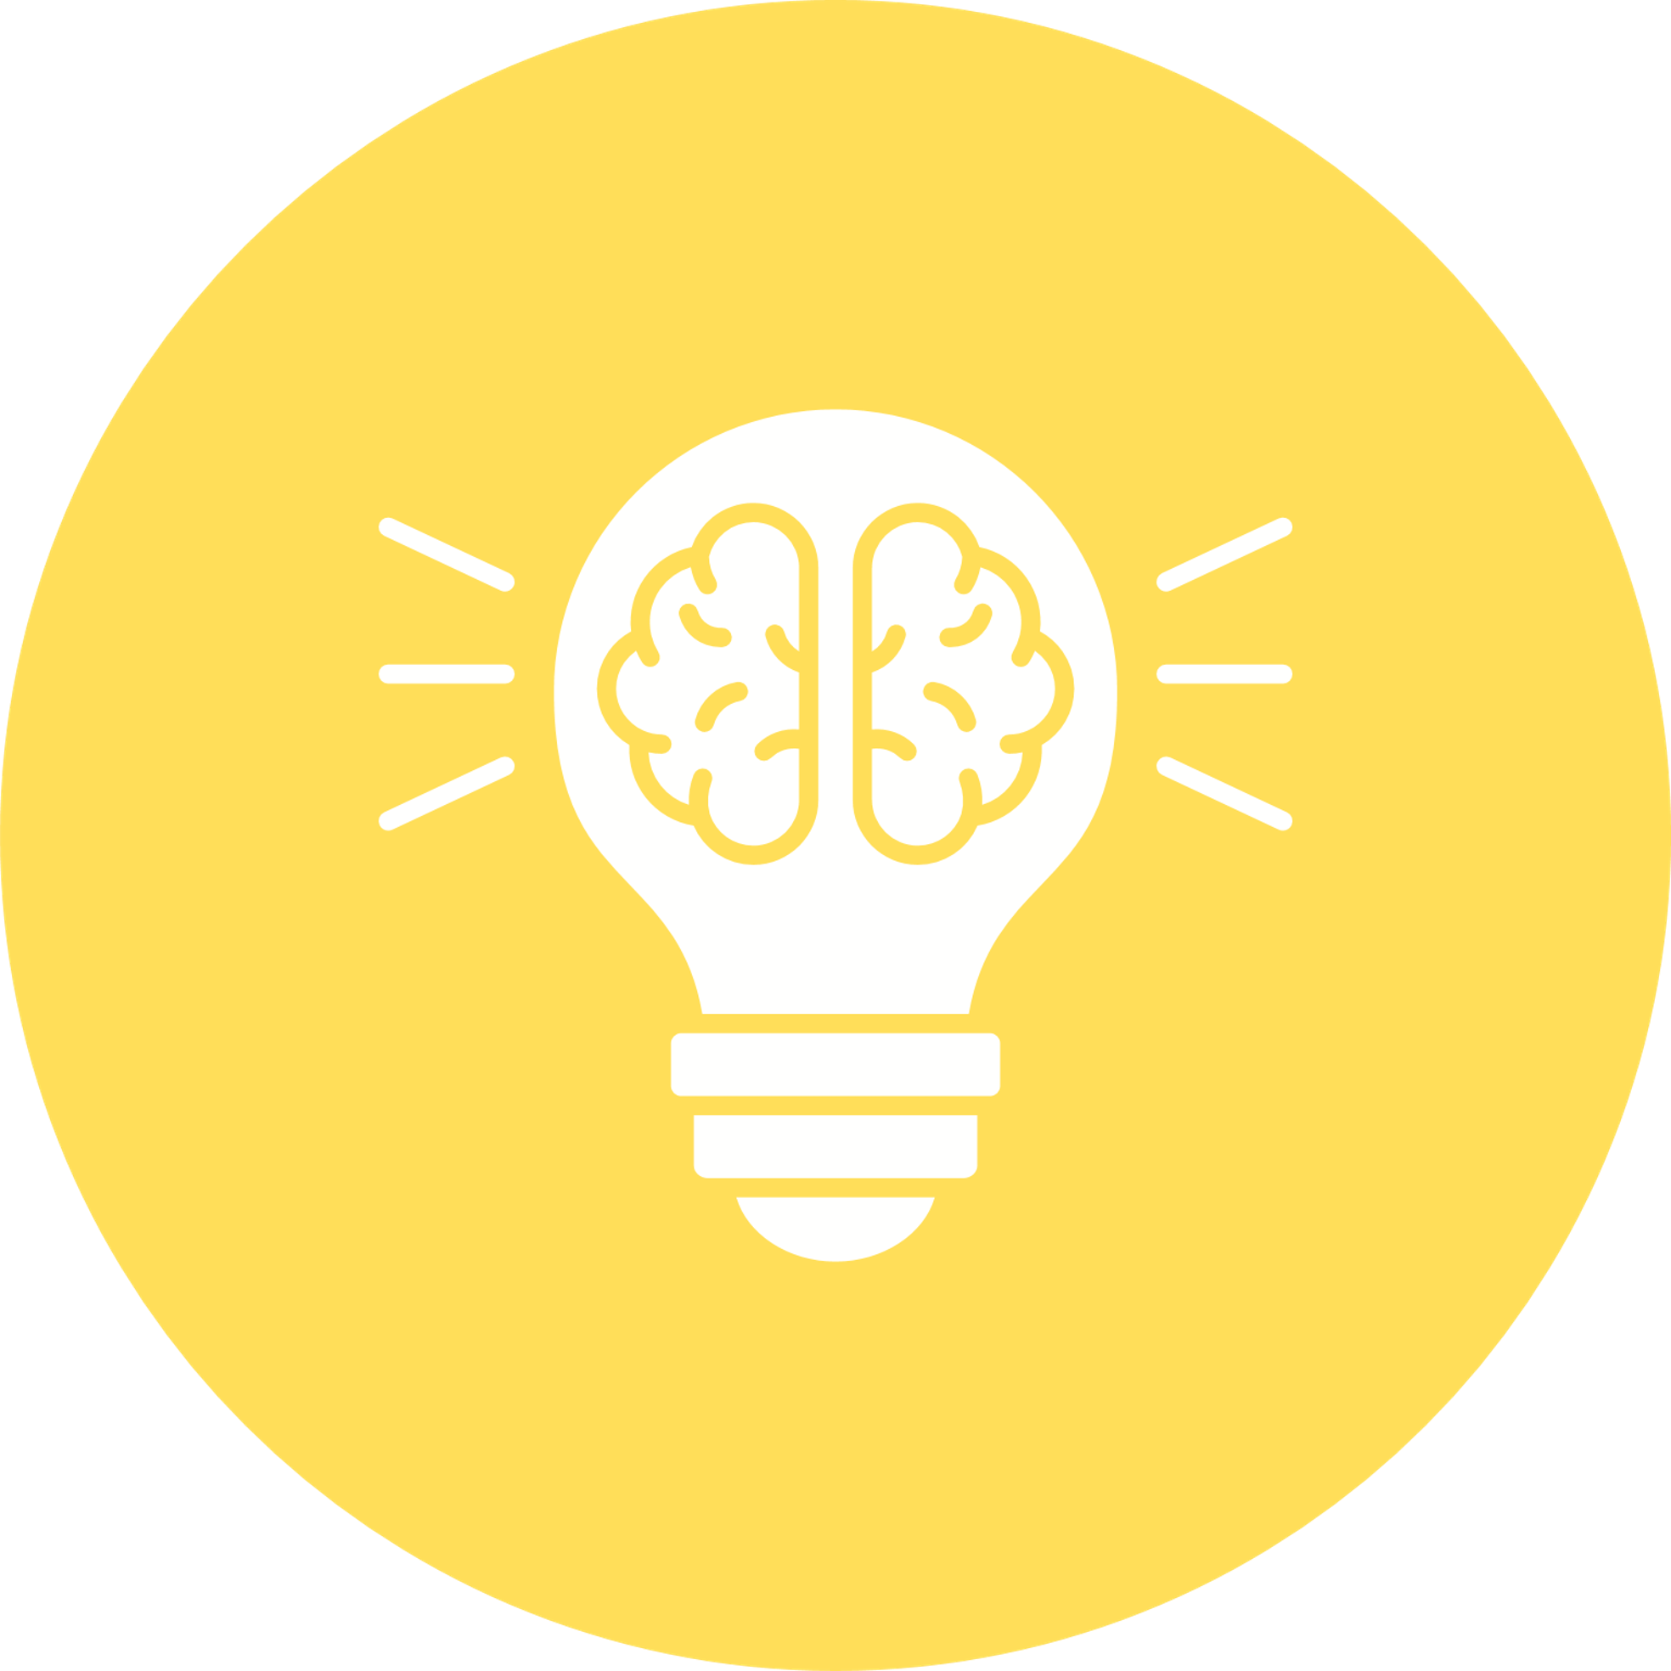
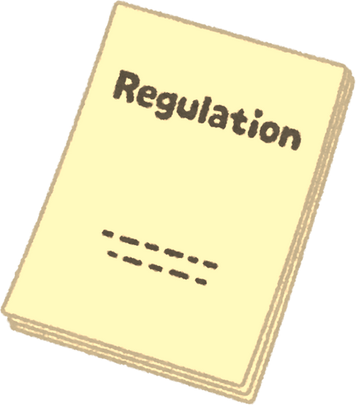
Understanding the Needs for the Green Transition:
SiT approach
The survey aimed to identify and map the green skills and competences required for 𝗕𝗶𝗼 𝘁𝗲𝘅𝘁𝗶𝗹𝗲 𝘁𝗲𝗰𝗵𝗻𝗶𝗰𝗶𝗮𝗻 and 𝗥𝗲𝗰𝘆𝗰𝗹𝗶𝗻𝗴 𝗠𝗮𝗻𝗮𝗴𝗲𝗿.
The research focussed on identifying the knowledge, competences, and skills needed to carry out these jobs
Semi-structured interviews were conducted with focus group representatives from each target group, aimed to gain qualitative
insights into the specific challenges and training requirements faced by professionals in the TCLF sector.
Data Mapping: An accompanying activity aimed at mapping specific skills against established frameworks to ensure alignment with existing standards to facilitate their application within the sector, such as the European Qualifications Framework (EQF) and ESCO systems.
SiT partnership developed the SiT GreenComp Framework as basis for the SiT training program: aligning training programs with industry needs, ensuring that both SMEs and educational institutions prepare the workforce for these 2 roles.
𝐑𝐞𝐠𝐮𝐥𝐚𝐭𝐨𝐫𝐲 𝐊𝐧𝐨𝐰𝐥𝐞𝐝𝐠𝐞
Soft skills
Technical skills

Slide 4
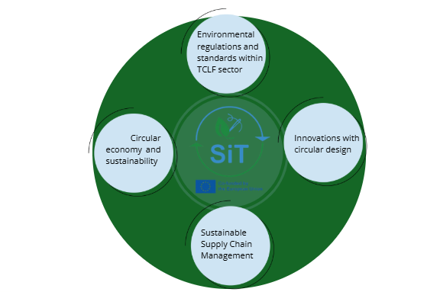
The SiT TCLF GreenComp Framework
According to the overall results of the survey, and in line with the existing GreenComp framework, SiT project developed the SiT TCLF GreenComp Framework:
It is divided into 4 competence areas which are sub-divided into topics and sub-topics.
These 4 competence areas are:
1.Environmental regulations and standards within TCLF sector
2.Circular Economy and Sustainability
3.Innovations with circular design
4.Sustainable Supply Chain Management
SIT Matrix for GreenComp Framework:
To get deeper in the matter find the full document in our website

Slide 5
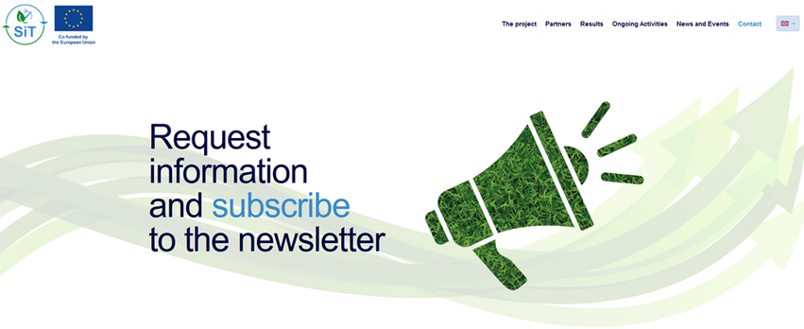
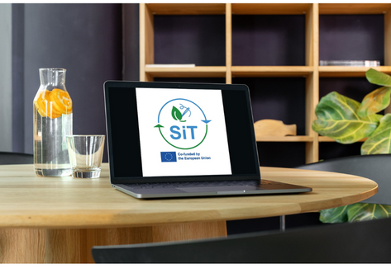
The research aims to identify and map the green skills and competences required for two emerging occupations in the (TCLF) sector: 𝗕𝗶𝗼 𝘁𝗲𝘅𝘁𝗶𝗹𝗲 𝘁𝗲𝗰𝗵𝗻𝗶𝗰𝗶𝗮𝗻 and 𝗥𝗲𝗰𝘆𝗰𝗹𝗶𝗻𝗴 𝗠𝗮𝗻𝗮𝗴𝗲𝗿.
The research focuses on defining and mapping these two occupations and identifying the knowledge, competences, and skills needed to carry out these jobs. The competences will be divided into three categories: functional, green, and transversal, depending on their role and significance in the 𝗴𝗿𝗲𝗲𝗻 𝘁𝗿𝗮𝗻𝘀𝗳𝗼𝗿𝗺𝗮𝘁𝗶𝗼𝗻 of the 𝗧𝗖𝗟𝗙 𝘀𝗲𝗰𝘁𝗼𝗿. This mapping will help align the identified skills and competences with existing frameworks and standards for better recognition and portability of skills across countries and sectors.
Be part of sustainable change and give us your opinion through this questionnaire field resource:
Let's keep in touch!
If you don't want to miss anything, sign up for newsletters and join our social media channels!
Do not hesitate to recommend to your friends, colleagues, contacts…
www.sitproject.eu

